Slide 1


Stats lecture 4
P-values and t-tests

Slide 2
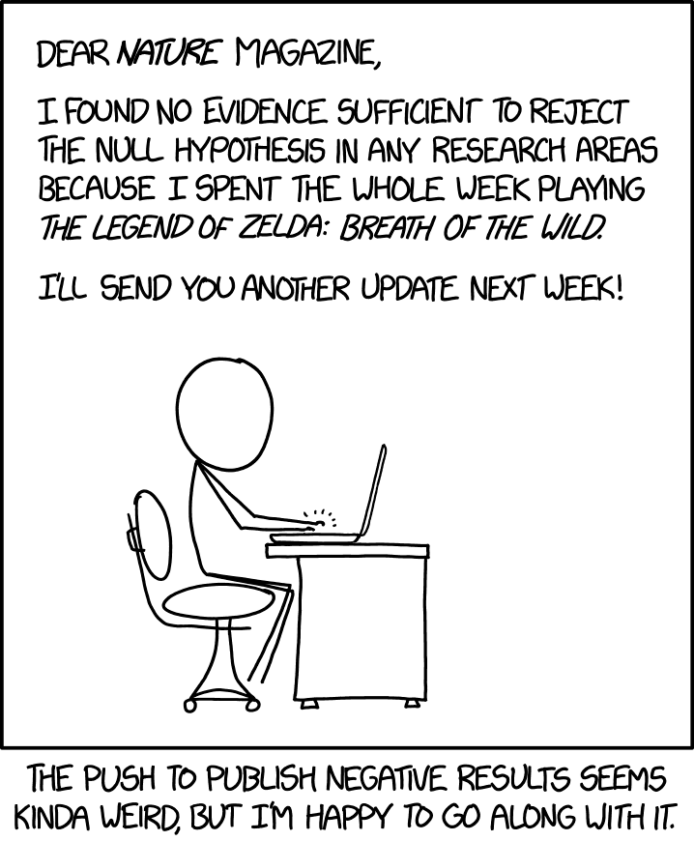
In Science we typically try and reject a null hypothesis

Slide 3
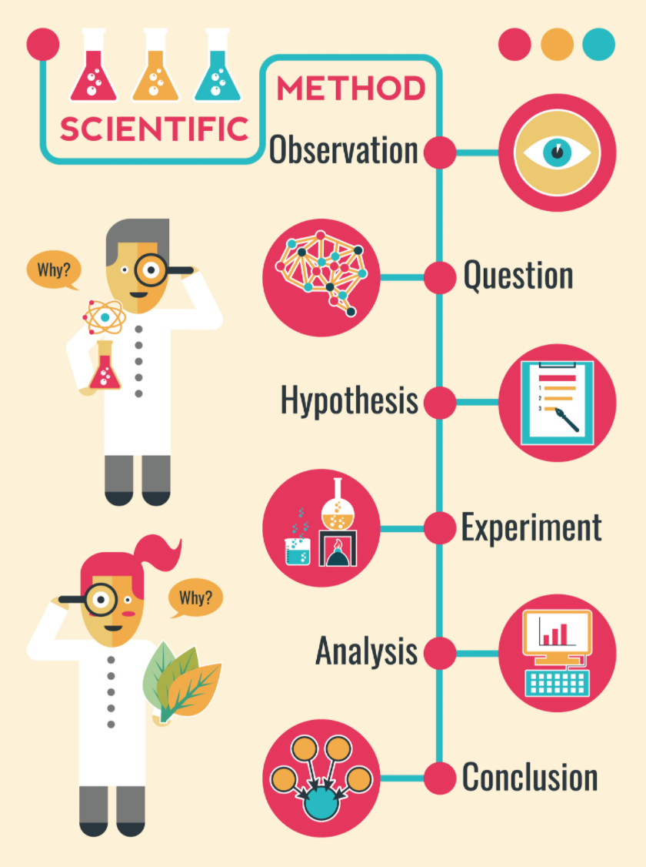

Forming your hypothesis
Step 1: Make some observations about the world
Step 2: Identify what causes these differences
Step 3: Form you question in a way that allows you to reject other explanations – Null testing
Step 4: Collect data or perform experiment
Step 5: Use some statistical test to compared the data to the Null expectation and try and show that the data is different enough to reject the Null explanation.

Slide 4
Forming your hypothesis
Step 1: Make some observations about the world
Example observation: Coral reef communities are more diverse compared to deep sea communities.

Slide 5
Forming your hypothesis
Step 2: Identify what causes these differences
Build a model of the world that explains your observations
Example model: Habitats with higher primary productivity have higher species richness

Slide 6
Step 3: Form you question in a way that allows you to reject other explanations
In science we typically try to reject other potential explanations for our observations. To do this we form the Null hypothesis and the alternative hypothesis.
Null = what we expect if our model does not explain our observations.
Alternative hypothesis = what we expect if our model does explain our observations.
Example: Our model is that primary productivity drives diversity so our Null hypothesis would be……

Slide 7
Step 3: Form you question in a way that allows you to reject other explanations
Null Hypothesis
Habitats with higher primary productivity do not have higher alpha diversity
Alternative Hypothesis
Habitats with higher primary productivity do have higher alpha diversity

Slide 8
Step 5: We now need to test if the data is different enough to reject the Null hypothesis.
Null Hypothesis
If we find that the diversity in both habitats is similar we cannot reject the Null explanation
Alternative Hypothesis
If we find that the diversity in both habitats is different enough we can reject the Null explanation leaving the alternative hypothesis as the explanation

Slide 9
P-values
The probability that the difference we observed was by chance
Or
The probability under the assumption of no effect or no difference (null hypothesis),
of obtaining a result equal to or more extreme than what was actually observed.

Slide 10
P-values
Lets imagine I flip a coin 20 times and I get 14 heads and 6 tails.
I want to check if my coin is a fair coin
Null: there is nothing unusual about the coin and the probability of a heads is 50%
Alternative: The coin is biased
P-value = the probability that a fair coin will give 14 or more heads in 20 flips = 0.058
P-values =
Probability of 14 heads
+ Probability of 15 heads
+ Probability of 16 heads
+ Probability of 17 heads
+ Probability of 18 heads
+ Probability of 19 heads
+ Probability of 20 heads
= 0.058
This means there is a 5.8% chance that a fair coin would give 14 or more heads in 20 throws

Slide 11
P-values
There is always the chance that we wrongly reject the null hypothesis so we decide beforehand what probability of rejecting the null incorrectly is acceptable
This is the alpha value and is typically 0.05 (5%)
In our example the p-value was 0.058 which is higher than 0.05
so we cannot reject the null (i.e. we accept the coin is fair)

Slide 12

However, we will sometimes reject the null just by chance
Example, we can simulate flipping a coin to show that
Lets create a simulation machine
And see how many times we would erroneously reject the null and think a fair coin is biased

Slide 13
However, we will sometimes reject the null just by chance
Example, we can simulate flipping a coin to show that
This is an empty vector that will save our results
no_heads <- c()
for(i in 1:100){
test <- sample(c("h","t"),
20,
replace = T,
prob = c(50,50))
no_heads[i] <- length(test[test=="t"])
}
This tell R to repeat the following 100 times
This part flips the coin
This adds up the number of heads

Slide 14
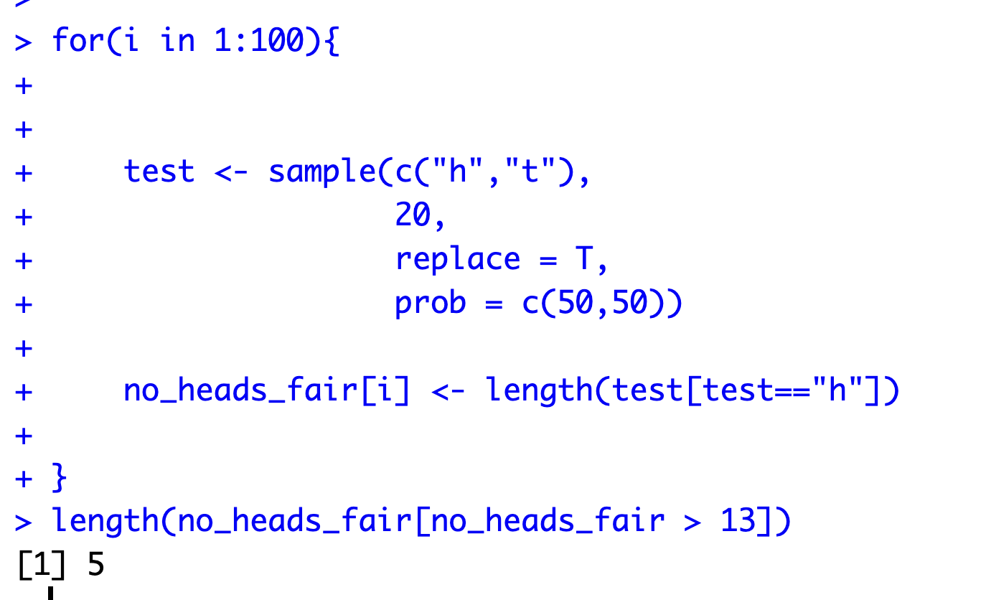
However, we will sometimes reject the null just by chance
Example, we can simulate flipping a coin to show that
We find that we get either 14 heads or more 5 times out of 100
We know the p-value of such an event happening is 0.058 meaning that in those 5 cases we would reject the null and say the coin is biased even though its fair!

Slide 15
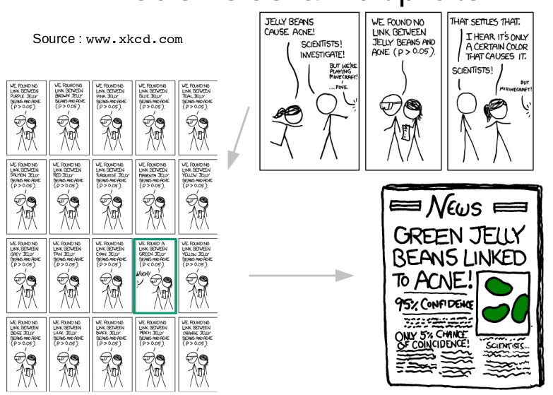
If we use an alpha value of 0.05 we will incorrectly reject the null 5% of the time

Slide 16
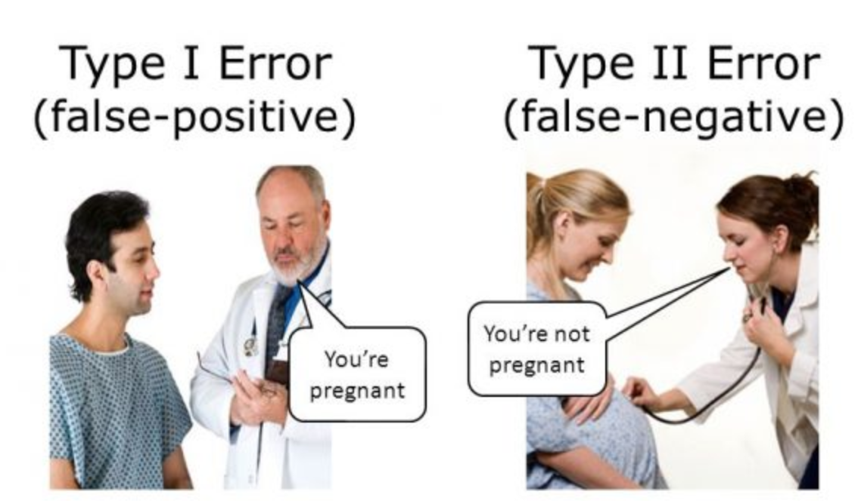
Type I error is when we erroneously reject the null
Type II error is when we erroneously fail to reject the null

Slide 17
One tail or two
Is my coin biased towards heads
One tail test: only asks if value is either significantly greater than or significantly less than some group in one direction.
Two tail test: only asks if the difference is significant, does not test if the value difference is less than or greater than the group
Is my coin biased in either direction? Does not test if the coin is biased towards head or tails

Slide 18
One tail or two
Example: The p-value for 14 head or more is 0.058 so the
1 tailed p-value is 0.058
One tail test: only asks if value is either significantly greater than or significantly less than some group in one direction.
Two tail test: only asks if the difference is significant, does not test if the value difference is less than or greater than the group
Example: The p-value for 14 head or more is 0.058 and the p-value for 5 heads or less is also 0.058 so overall 2 tailed
p – value = 0.0115

Slide 19
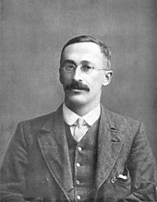
William Gosset, wanted to test how barely
was affecting the brewing process
Needed a test to test if different batches had different properties.

Slide 20

Batch A
William Gosset, wanted to test how barely
was affecting the brewing process
Needed a test to test if different batches had different properties.
For example, whether batch A had a higher alcohol content compared to batch B.
Each batch has 6 test pints which we can measure the amount of alcohol
5.3
5.0
5.9
6.5
6.9
5.9
Batch B
4.5
5.0
3.9
4.0
3.5
3.0

Slide 21
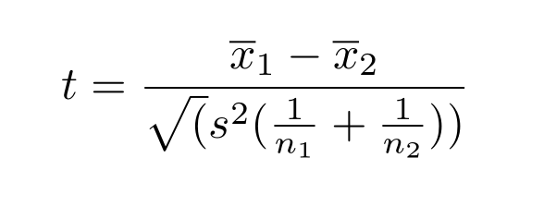
Batch A
Students t-test
5.3
5.0
5.9
Compare the means of the two groups but also account for the variation in each group.
6.5
6.9
5.9
Mean of batch 1
Mean of batch 2
t-value
Batch B
4.5
5.0
3.9
Sample size of each group
Variance within each group
(assumed to be the same in both groups)
4.0
3.5
3.0

Slide 22
Batch A
Students t-test
5.3
5.0
5.9
Compare the means of the two groups but also account for the variation in each group.
6.5
6.9
5.9
6
4
Batch B
0.5
6
6
4.5
5.0
3.9
4.0
3.5
3.0

Slide 23
Batch A
Students t-test
5.3
5.0
5.9
This t-value contains information of how different the two groups are given the variation and sample sizes
6.5
6.9
5.9
We can then use it to compare to a distribution to ask how likely such a difference was i.e. a p-value
Batch B
4.89
4.5
5.0
3.9
4.0
3.5
3.0

Slide 24
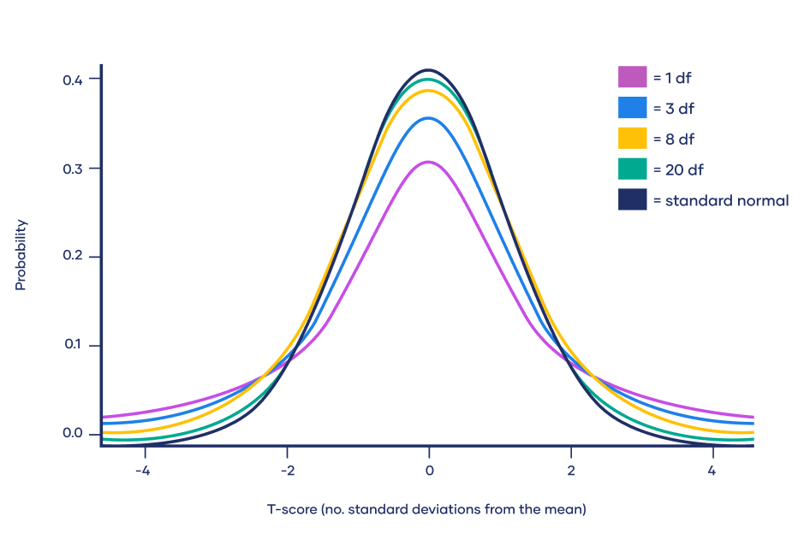
Batch A
Students t-test
5.3
5.0
5.9
This t-value contains information of how different the two groups are given the variation and sample sizes
6.5
6.9
5.9
We draw a t-distribution based on the number of samples (degrees of freedom).
With the t-value we can check how likely the difference was in our two groups was by chance
Batch B
4.5
5.0
3.9
Our t-value of 4.89 is very unlikely
To have happened by chance
4.0
3.5
3.0

Slide 25
Degrees of freedom
The t-distribution we compare our t-value depends on the degrees of freedom
Higher degrees of freedom typically means you have a higher sample size and you are more sure about what you observed.

Slide 26

Degrees of freedom
Degree of freedom: the number of independent pieces of information available to calculate the statistic.
Imagine we have 7 hats but can only wear each for 1 day
Day 1: We have full choice from 7 hats
…
…
Day 6: We still have 2 hats to choose from
Day 7: We no choice, the degree of freedom = 0

Slide 27
Degrees of freedom
Degree of freedom: the number of independent pieces of information available to calculate the statistic.
The degrees of freedom (d.f.) can typically be calculated as
d.f. = N – P
Where N is the sample size and P is the number of parameters.

Slide 28
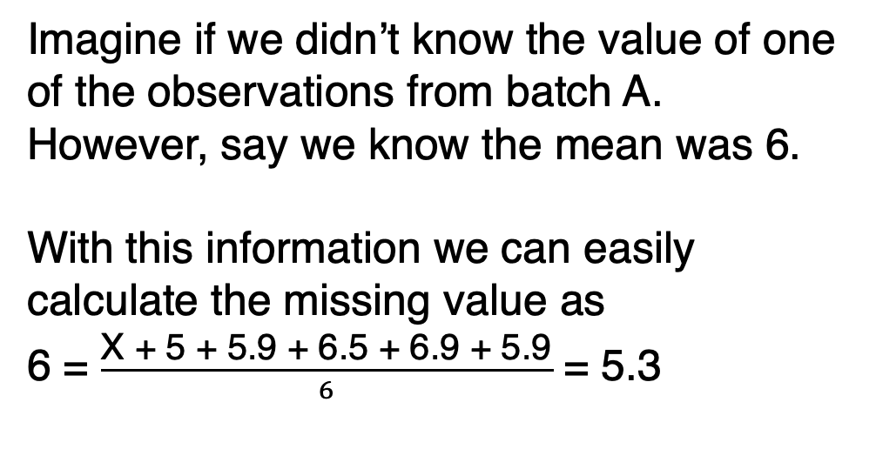
Degrees of freedom
Degree of freedom: the number of independent pieces of information available to calculate the statistic.
Batch A
Imagine if we didn’t know the value of one of the observations from batch A.
However, say we know the mean was 6.
With this information we can easily calculate the missing value as
6 = $\frac{\text{X}\text{ + 5 + 5.9 + 6.5 + 6.9 + 5.9}}{6}$ = 5.3
X
5.0
5.9
6.5
6.9
5.9

Slide 29
Degrees of freedom
Degree of freedom: the number of independent pieces of information available to calculate the statistic.
For a t-test the 2 parameters we need to calculate are the mean of group 1 and the mean of group 2 so for our case
d.f. = N – 2
*please note that there are different ways of calculating d.f. but generally this is the central idea

Slide 30
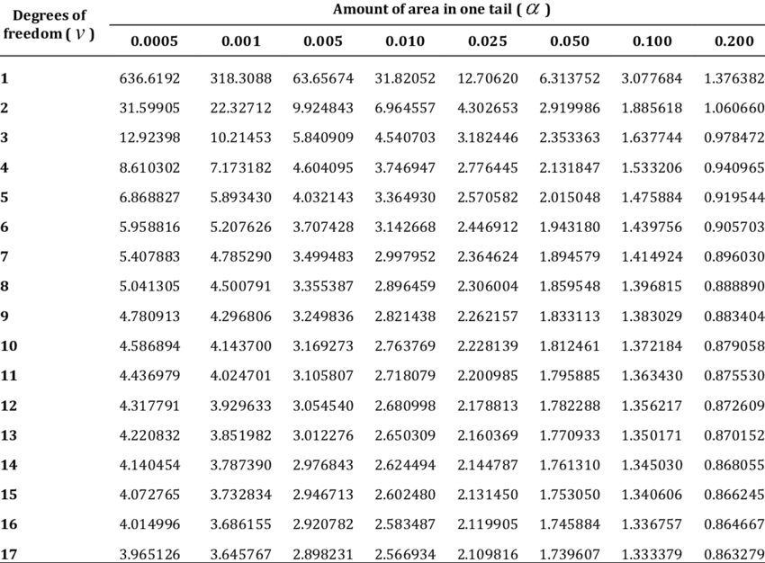
Batch A
Students t-test
We used to use tables to get the p-value from the distribution based on the degrees of freedom and t-value, now we have R
5.3
5.0
5.9
6.5
6.9
5.9
Batch B
4.5
5.0
3.9
4.0
3.5
3.0

Slide 31

Batch A
Students t-test
T test in R
5.3
5.0
5.9
batch_a <- c(5.3, 5, 5.9, 6.5, 6.9, 5.9)
batch_b <- c(4.5, 5, 3.9, 4.0, 3.5, 3.0)
t.test(batch_a, batch_b, var.equal = TRUE)
6.5
6.9
5.9
Batch B
4.5
5.0
3.9
4.0
3.5
3.0

Slide 32
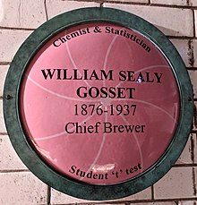
William Gosset

Slide 33
Assumptions
Students t-test
This is often not the case
Variance within each group
(assumed to be the same in both groups)

Slide 34
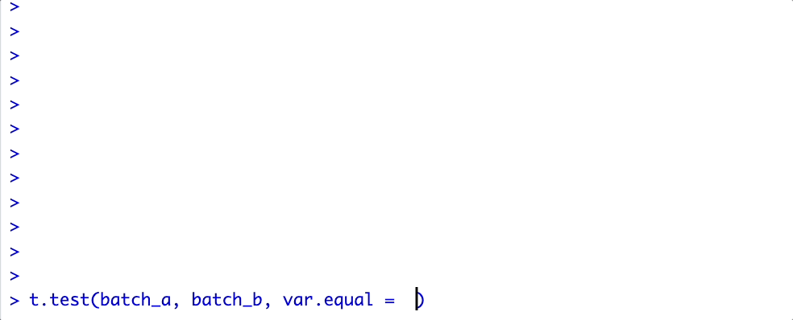
Welch's t-test
Welch's t-test does not make this assumption. As it requires more parameters its degrees of freedom is slightly lower but this is a very minor inconvenience
This is the default in R

Slide 35
Rank 5
Batch A
Mann Whitney U test
Rank 8
Rank 6
Rank 9
Both Welch's and students t-tests assume both groups have a normal distributions.
The Mann Whitney U does not compare the mean differences of two groups it compares the rank sum
To do this we rank each value across both groups from the smallest (rank 1) to the largest (rank 2)
We now add up the rank sum (R₁, R₂) of each group
R₁ = 6 + 8 + 9 + 10 + 11 + 12 = 56
R₂ = 1 + 2 + 3 + 4 + 5 + 7 = 22
The significance test uses these numbers,
not the differences between the means.
5.3
5.0
5.9
Rank 11
Rank 12
Rank 10
6.5
6.9
5.9
Batch B
Rank 5
Rank 7
Rank 3
4.5
5.1
3.9
Rank 4
Rank 2
Rank 1
4.0
3.5
3.0

Slide 36
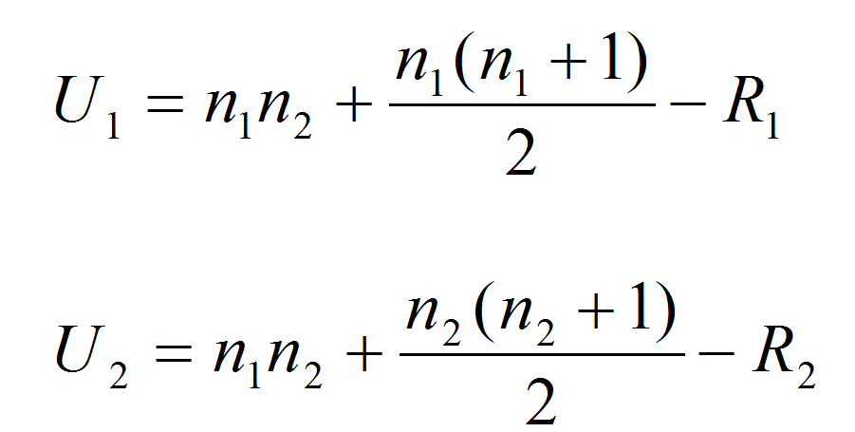
Rank 5
Batch A
Mann Whitney U test
Rank 8
Rank 6
Rank 9
Both Welch's and students t-tests assume both groups have a normal distributions.
The Mann Whitney U does not compare the mean differences of two groups it compares the rank sum
We than calculate U values using the R values and sample size n for each group
5.3
5.0
5.9
Rank 11
Rank 12
Rank 10
6.5
6.9
5.9
Batch B
Rank 5
Rank 7
Rank 3
4.5
5.1
3.9
Rank 4
Rank 2
Rank 1
4.0
3.5
3.0

Slide 37
Rank 5
Batch A
Mann Whitney U test
Rank 8
Rank 6
Rank 9
Both Welch's and students t-tests assume both groups have a normal distributions.
The Mann Whitney U does not compare the mean differences of two groups it compares the rank sum
We than calculate two U values using the R values and sample size n for each group and pick the smallest value
5.3
5.0
5.9
Rank 11
Rank 12
Rank 10
6.5
6.9
5.9
Batch B
6
6
Rank 5
Rank 7
Rank 3
(6)(6)
56
= 1
4.5
5.1
3.9
6
Rank 4
Rank 2
Rank 1
6
(6)(6)
22
= 35
4.0
3.5
3.0

Slide 38
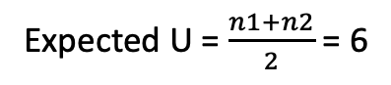
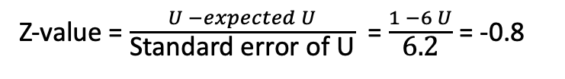
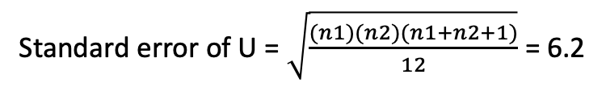
Rank 5
Batch A
Mann Whitney U test
Rank 8
Rank 6
Rank 9
We than calculate two U values using the R values and sample size n for each group and pick the smallest value
We then compare the smaller value to the expected value U and standard error values, which are both calculated using the sample sizes to get a z value
5.3
5.0
5.9
Rank 11
Rank 12
Rank 10
6.5
6.9
5.9
Expected U = $\frac{n1+n2}{2}$ = 6
Batch B
Rank 5
Rank 7
Rank 3
Standard error of U = $\sqrt{\frac{(n1)(n2)(n1+n2+1)}{12}}$ = 6.2
4.5
5.1
3.9
Z-value = $\frac{U −expected U}{\text{Standard} \text{error} \text{of} \text{U}}$ = $\frac{1 −6 U}{\text{6.2}}$ = -0.8
Rank 4
Rank 2
Rank 1
We can then get a p-value by comparing this Z-value to a table or
Distribution like we did in the students t-test
4.0
3.5
3.0

Slide 39

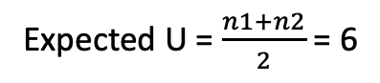
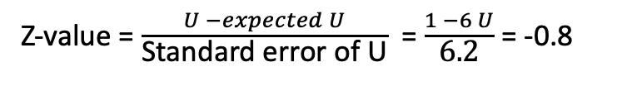
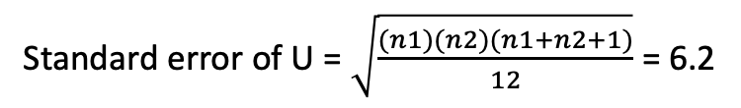
Rank 5
Batch A
This is a lot of work so we can leave R do all the heavy lifting
Rank 8
Rank 6
Rank 9
We than calculate two U values using the R values and sample size n for each group and pick the smallest value
And compare the smaller value to the expected value U and standard error values, which are both calculated using the sample sizes.
5.3
5.0
5.9
Rank 11
Rank 12
Rank 10
6.5
6.9
5.9
Expected U = $\frac{n1+n2}{2}$ = 6
Batch B
Rank 5
Rank 7
Rank 3
Standard error of U = $\sqrt{\frac{(n1)(n2)(n1+n2+1)}{12}}$ = 6.2
4.5
5.1
3.9
Z-value = $\frac{U −expected U}{\text{Standard} \text{error} \text{of} \text{U}}$ = $\frac{1 −6 U}{\text{6.2}}$ = -0.8
Rank 4
Rank 2
Rank 1
We can then get a p-value by comparing this value to a table or
Distribution like we did in the students t-test
4.0
3.5
3.0

Slide 40
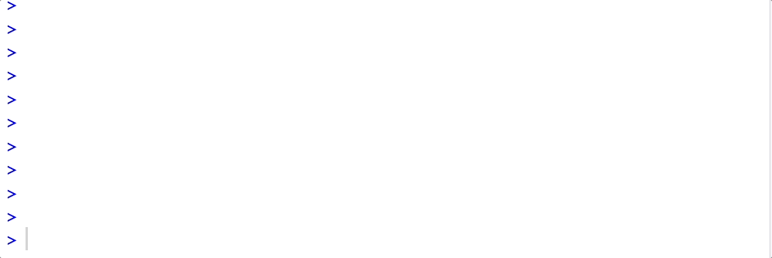
Rank 5
Batch A
This is a lot of work so we can leave R do all the heavy lifting
Rank 8
Rank 6
Rank 9
5.3
5.0
5.9
Rank 11
Rank 12
Rank 10
6.5
6.9
5.9
Batch B
Rank 5
Rank 7
Rank 3
4.5
5.1
3.9
Rank 4
Rank 2
Rank 1
4.0
3.5
3.0

Slide 41
Rank 5
Batch A
Mann Whitney U test is more likely to have type II errors (its harder to reject the null with this test).
However, as long as the distributions between the two groups is similar it’s a safe bet to use as a test.
Rank 8
Rank 9
Rank 6
5.3
5.0
5.9
Rank 11
Rank 12
Rank 10
6.5
6.9
5.9
Batch B
Rank 5
Rank 7
Rank 3
4.5
5.1
3.9
Rank 4
Rank 2
Rank 1
4.0
3.5
3.0

Slide 42

Paired T-test
Sometimes our data is not completely independent
In one special case it can be called paired
If we wanted to compare the finger lengths between my left and right hands we might notice that the values are paired.
The length of each finger is likely to correspond to the same finger on the other hand.
For example, the left thumb is likely to be similar to the right thumb
We can tell R the data is structure like this by making our t-test paired.

Slide 43

Paired t-test
Pints before added sugar
Imagine we wanted to test the effect adding sugar has to alcohol levels. We now have 6 pints before and after the addition of sugar.
We will want to compare the before group (batch_b)
to the after group (batch_a) but also tell R that values in each group are paired (they are the same pints just before and after).
Value 1 in batch_b is paired with value 1 in batch_a,
Value 2 in batch_b is paired with value 2 in batch_a, etc.
4.5
5.0
3.9
4.0
3.5
3.0
t.test(batch_b, batch_a, paired = T)
Pints after added sugar
5.3
5.0
5.9
6.5
6.9
5.9

Slide 44
Summary
We use p-value to decide when to reject the Null
P-value is the probability of wrongly rejecting the null (assuming the null is correct)
One tailed only tests if values are greater or less than expectation in one direction
Type II error versus type II errors
T-test compare the means between two groups
Welch's t-test does not assume equal variance between groups
Mann Whitney U test does not assume normal distributions
Paired T-test can be used for groups with paired values (before/after)

